Slide 1
Conversational Commerce
Azure Bot Service

Slide 2

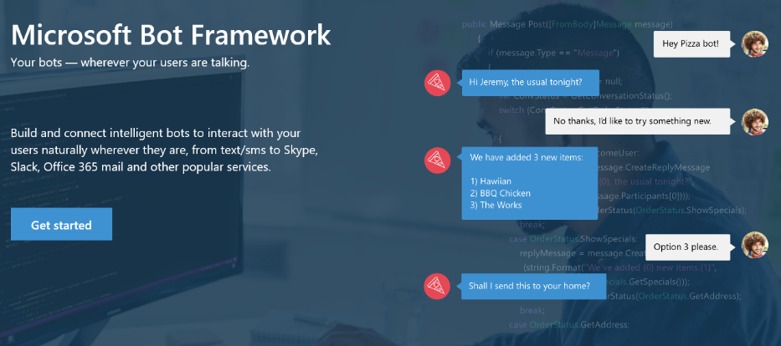
Your bots – wherever your users converse
Your Bots – where your users converse
Intelligence
Cognitive Services
Bot Framework
Cortana
Bot Connector Service: A service to register your bot, configure channels and publish to the Bot Directory. Connect your bot(s) seamlessly to text/sms, Office 365 mail, Skype, Slack, Twitter, and more.
Bot Builder SDK: An open source SDK hosted on GitHub. Everything you need to build great dialogs within your Node.js or C# bot
Bot Directory: A public directory of bots registered through the Bot Connector Service. Discover, try, and add bots to conversation experiences
Notes:
Microsoft Bot Framework enables organizations to build intelligent agents (Bots) that allow your intelligent systems to interact with your users in more contextual and natural ways, from text/sms to Office365 mail to Skype, Slack and other services. The Bot Framework provides developers with a developer portal & SDK to build your bot, a bot connector service to connect to social channels such as Twitter, Slack etc. and a bot directory to discover and use existing bots.
T: Next, Cortana.

Slide 3
Bot Framework ( Conversational Commerce )
Intelligence
Introduction
Azure Bot Service
Bot Builder
Cognitive Services
App Economy to Bot Economy
Basic
Introduction + SDKs
Bot Framework
Conversational Commerce
Form
Bot Simulator
Cortana
About Azure Bot Framework
LUIS
Bot Connectors
Industry Case Studies
Proactive
Bot Framework Portal
Q&A

Slide 4
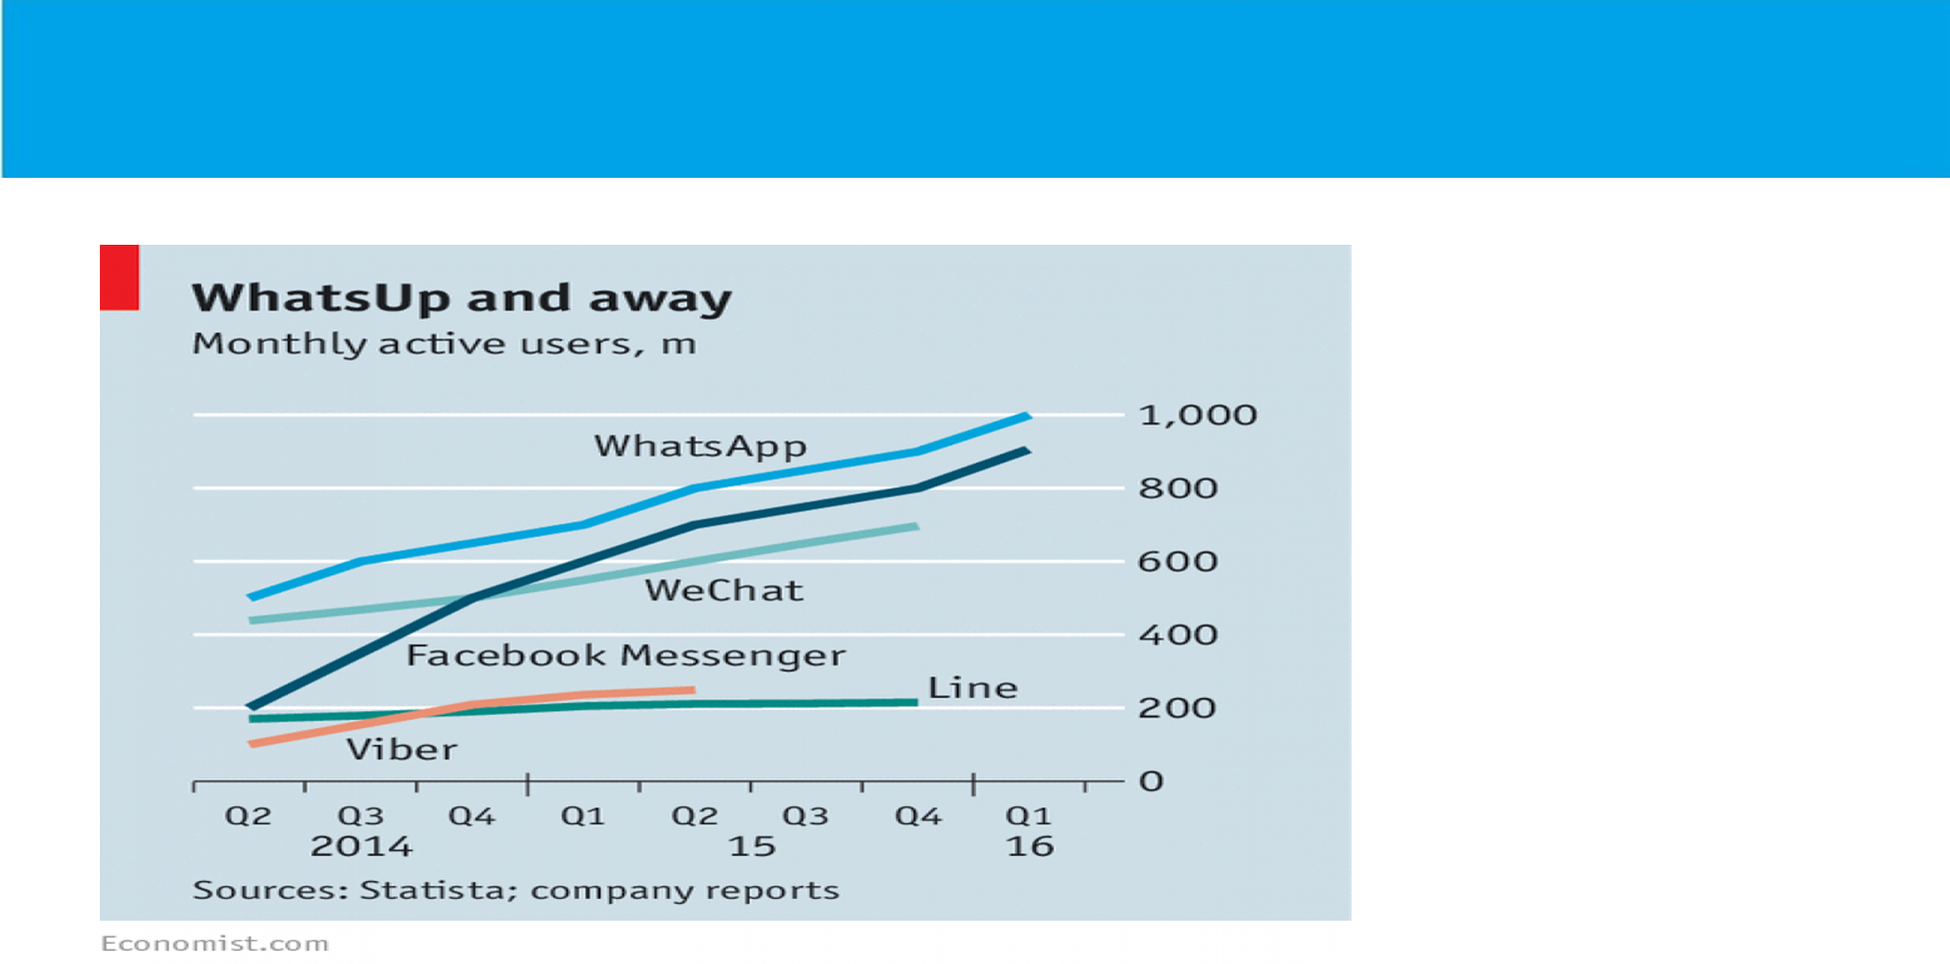

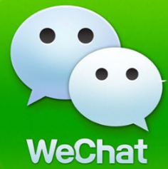

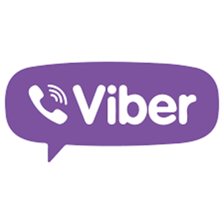
App Economy to Bot Economy

Slide 5
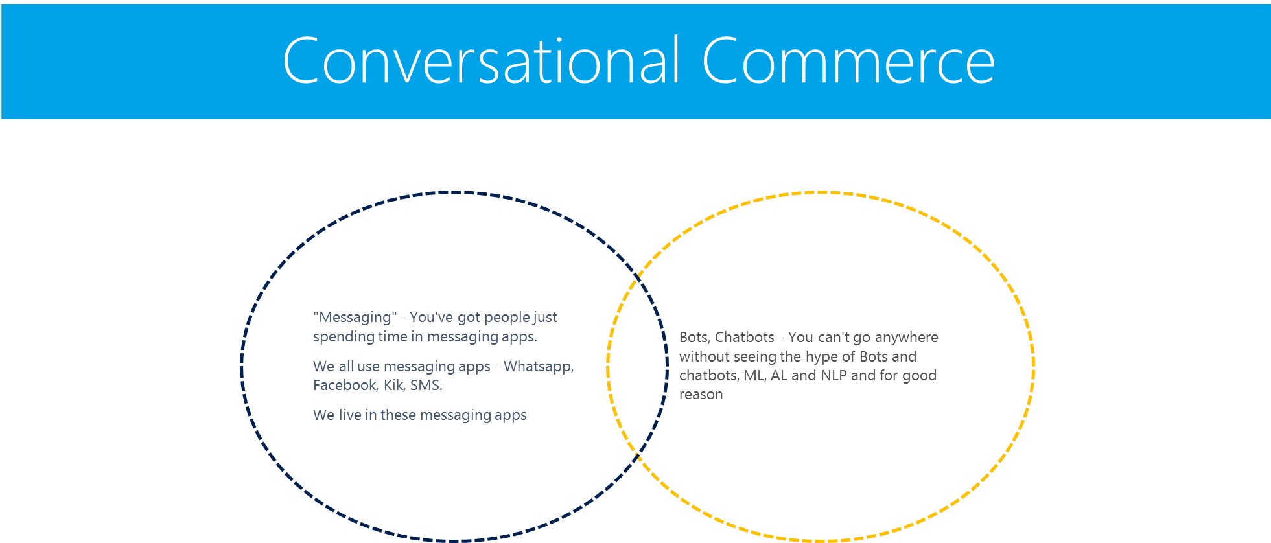

Slide 6
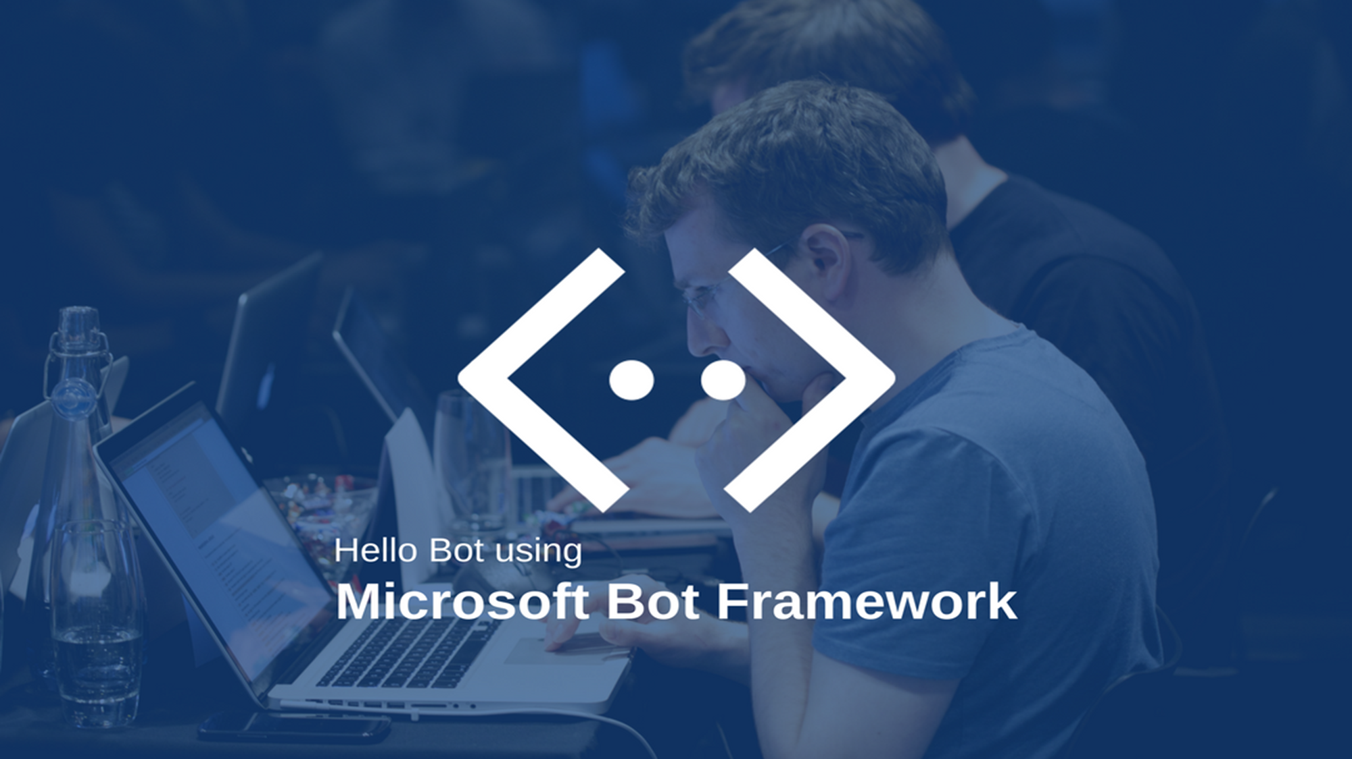
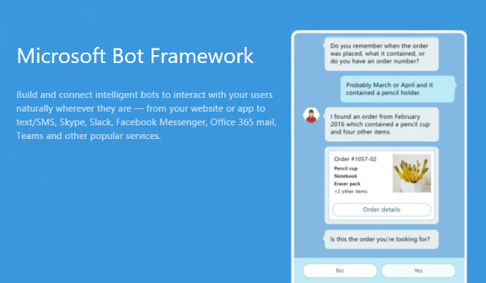
Notes:
About Bot Framework
The Bot Framework is a platform for building, connecting, testing, and deploying powerful and intelligent bots. You can quickly start building bots with the Azure Bot Service. If you prefer building a bot from scratch, the Bot Framework provides the Bot Builder SDK for .NET and Node.js.
Let's look at an example of a bot that schedules salon appointments. The bot understands the user's intent, presents appointment options using action buttons, displays the user's selection when they tap an appointment, and then sends a thumbnail card that contains the appointment's specifics.

Slide 7
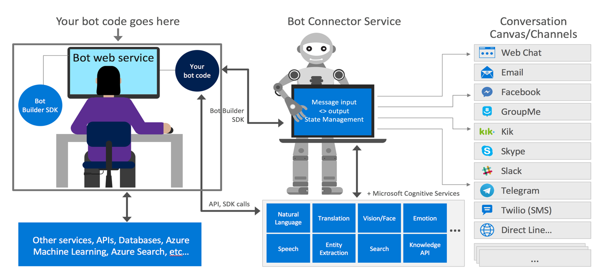
Bot Frame Work Components

Slide 8

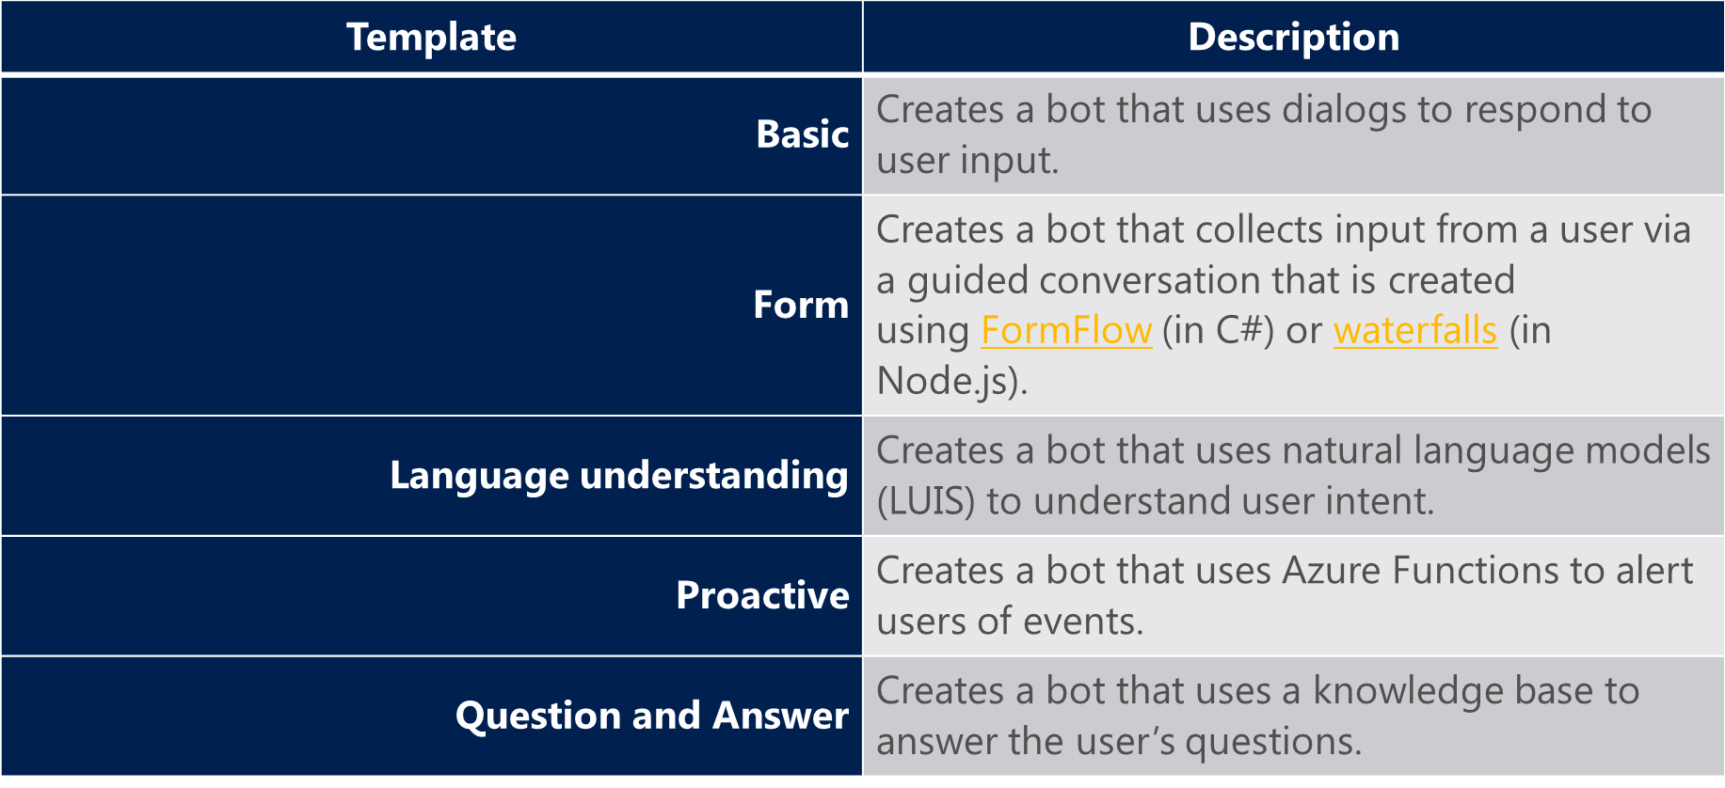

Slide 9
Planning for Bot Projects
PHASES | ACTIVITIES | INPUTS | OUTPUTS | TOOLS & TECHNIQUES
Initiating | Industry Type Identification | Discussions with Stake holders | Industry Type Definition | Meetings/Emails
 | Use Cases | Discussions with Stake holders | Use cases | Meetings/Emails
Planning | ChatBot Type-LUIS (Q&A, LUIS, Deep Learning) | Use cases | ChatBot Type | Use cases
 | Bot Builder(C#, Node.js) | Use Cases | Type of Bot Builder | Use cases
 | List of Intents | Use Cases | Intents | Bot Framework
 | List of Entities | Intents | Entities | Bot Framework
 | List of utterences | Entities | Utterences | Bot Framework
 | List of API's to be integrated | Intents,Entities,Utterences,Use cases | API's | Node.js
 | Channel for Publishing (Skype,Slack,Messenger,Email,FB,KIK) | Stake holder inputs | Channel | Selected Channel

Slide 10
Planning for Bot Projects
PHASES | ACTIVITIES | INPUTS | OUTPUTS | TOOLS & TECHNIQUES
Executing | Create Azure subscription | subscription detilas | Azure account to create a bot | Azure Portal
 | Creating a Bot | MS Bot framework | Basic Bot | Bot Framework
 | Train Intents,Entity and Utterences | List of Intents,Entities,utterences | Trained Bot | Bot Framework
 | Integrate the API's | Api's List | Bot | Bot Framework
 | Deploy the Bot | Bot |  | Bot Framework
 | Connect to channel | Identified Channel | Availability of Bot on identified Channel | Selected Channel
Monitering Controlling | Test the Bot | Bot | Modifications Required | Bot Framework
 | Modify the bot source and redeploy the Bot | Modifications | Modified Bot | Bot Framework
Closing | Publish the Bot | Modified Bot | Final Bot | Selected Channel
Notes:
Entities
Utterances

Slide 11
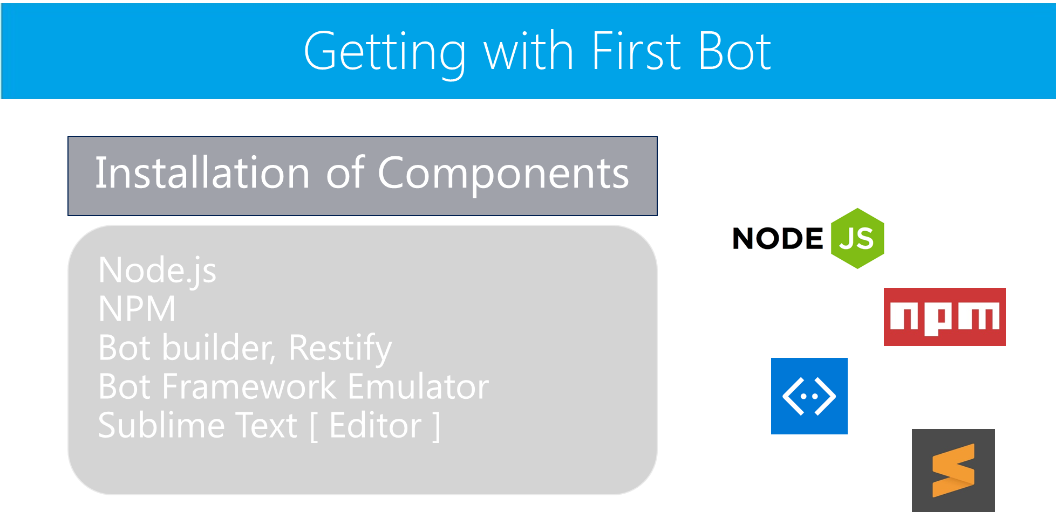

Slide 12
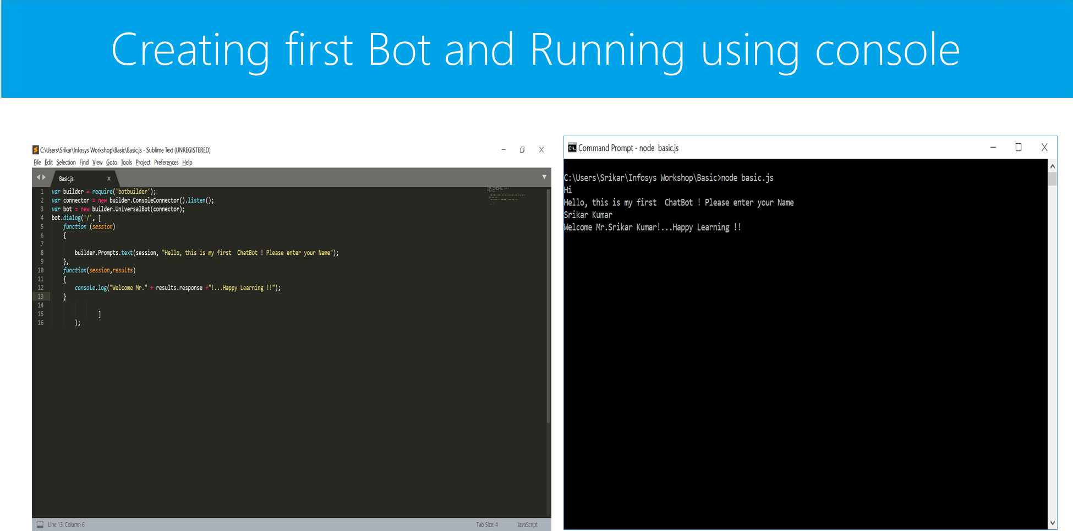

Slide 13
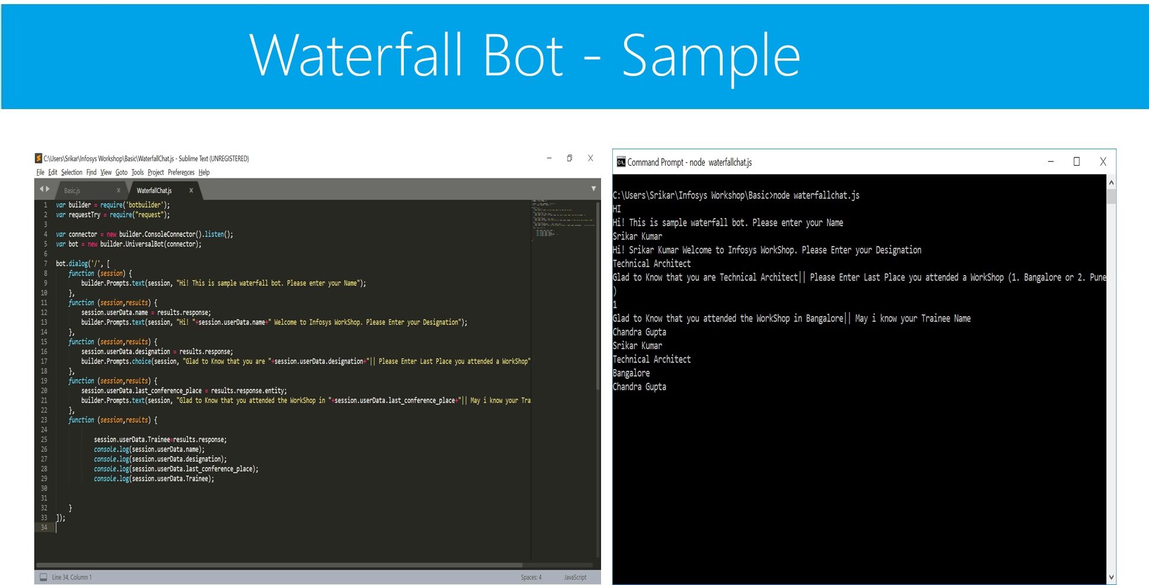

Slide 14


Slide 15
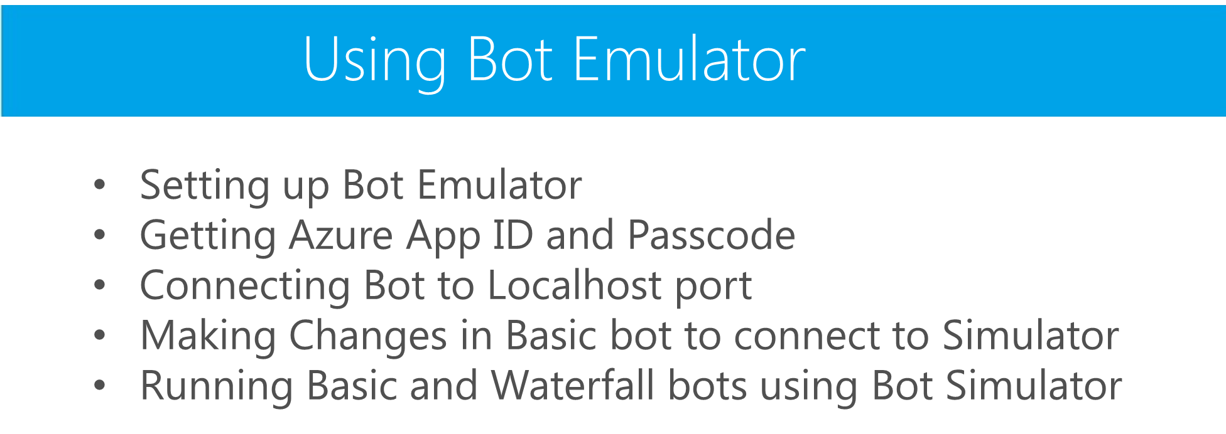

Slide 16
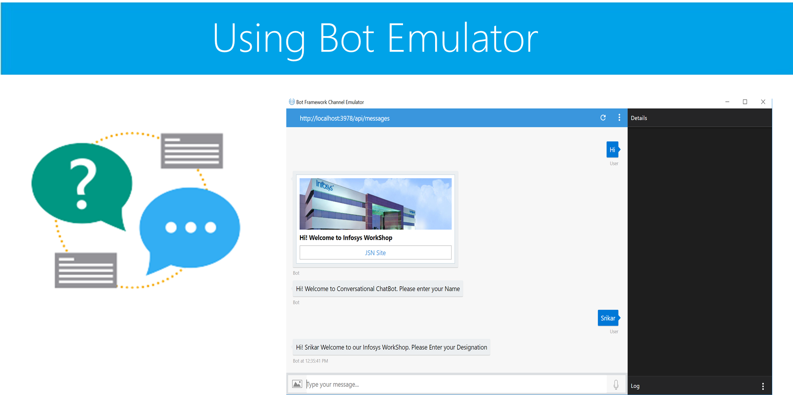

Slide 17

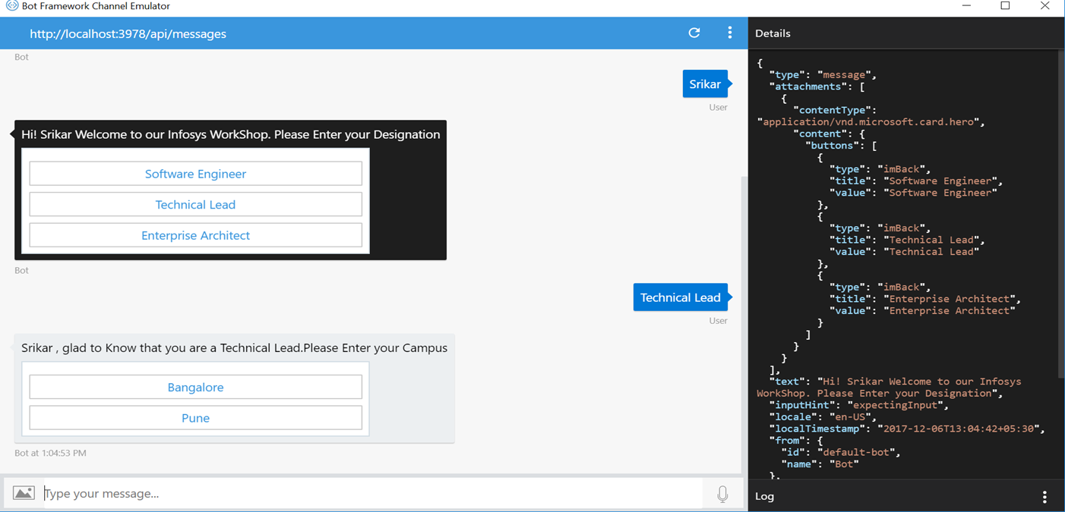

Slide 18

Hands on Lab

Slide 19
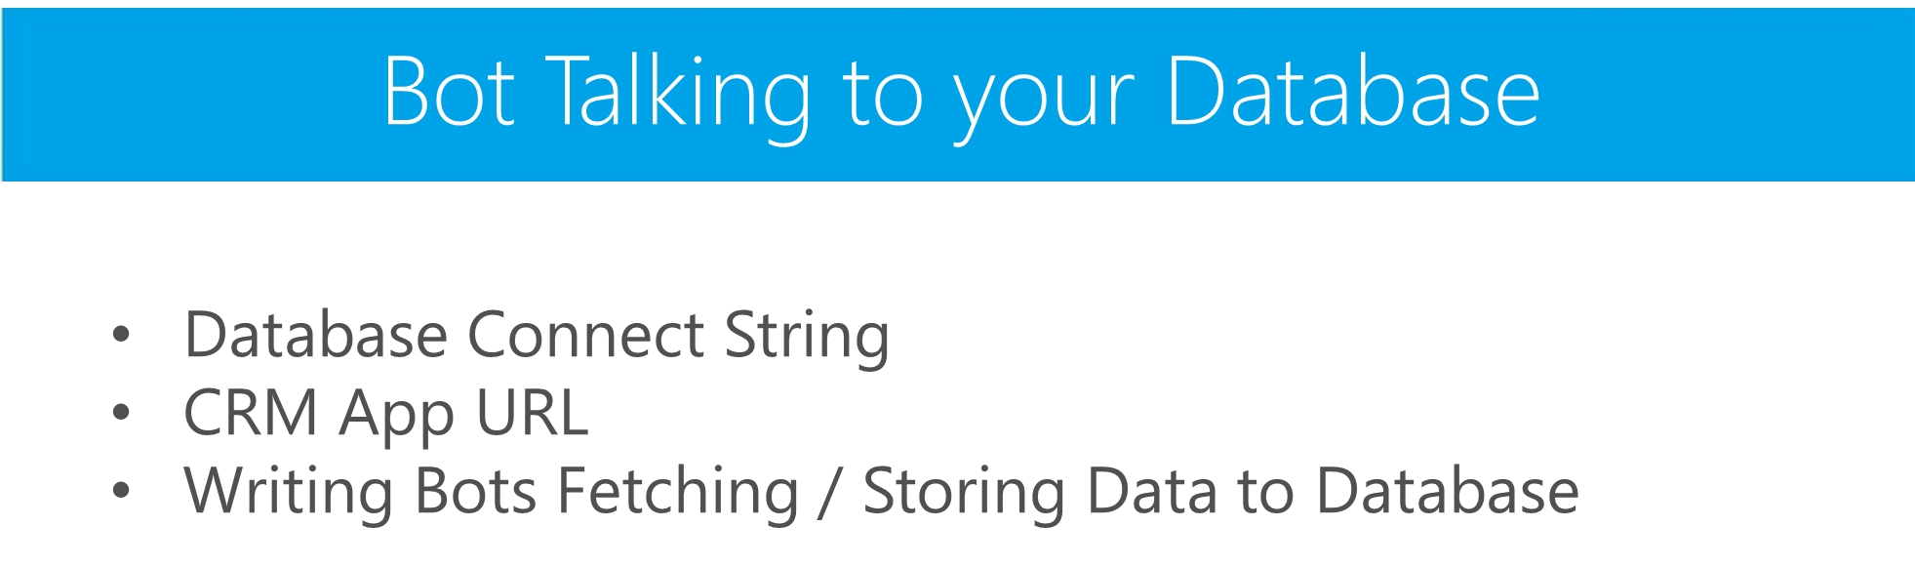

Slide 20

Hands on Lab

Slide 21

From FAQ to Bot in minutes.
Build,train and publish a simple question and answer bot based on FAQ URLs,structured documents or editorial content in minutes.

Slide 22
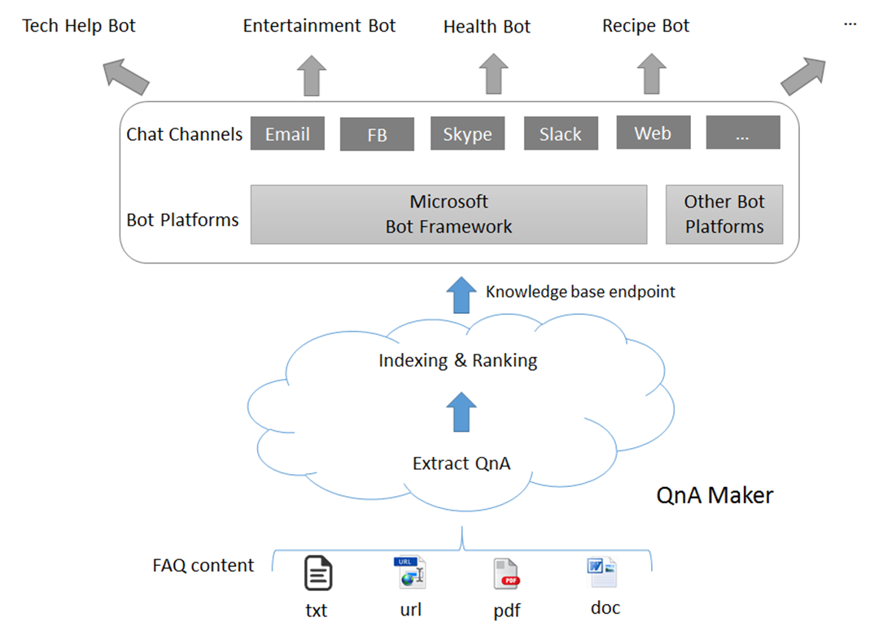
Development of FAQ Bots

Slide 23
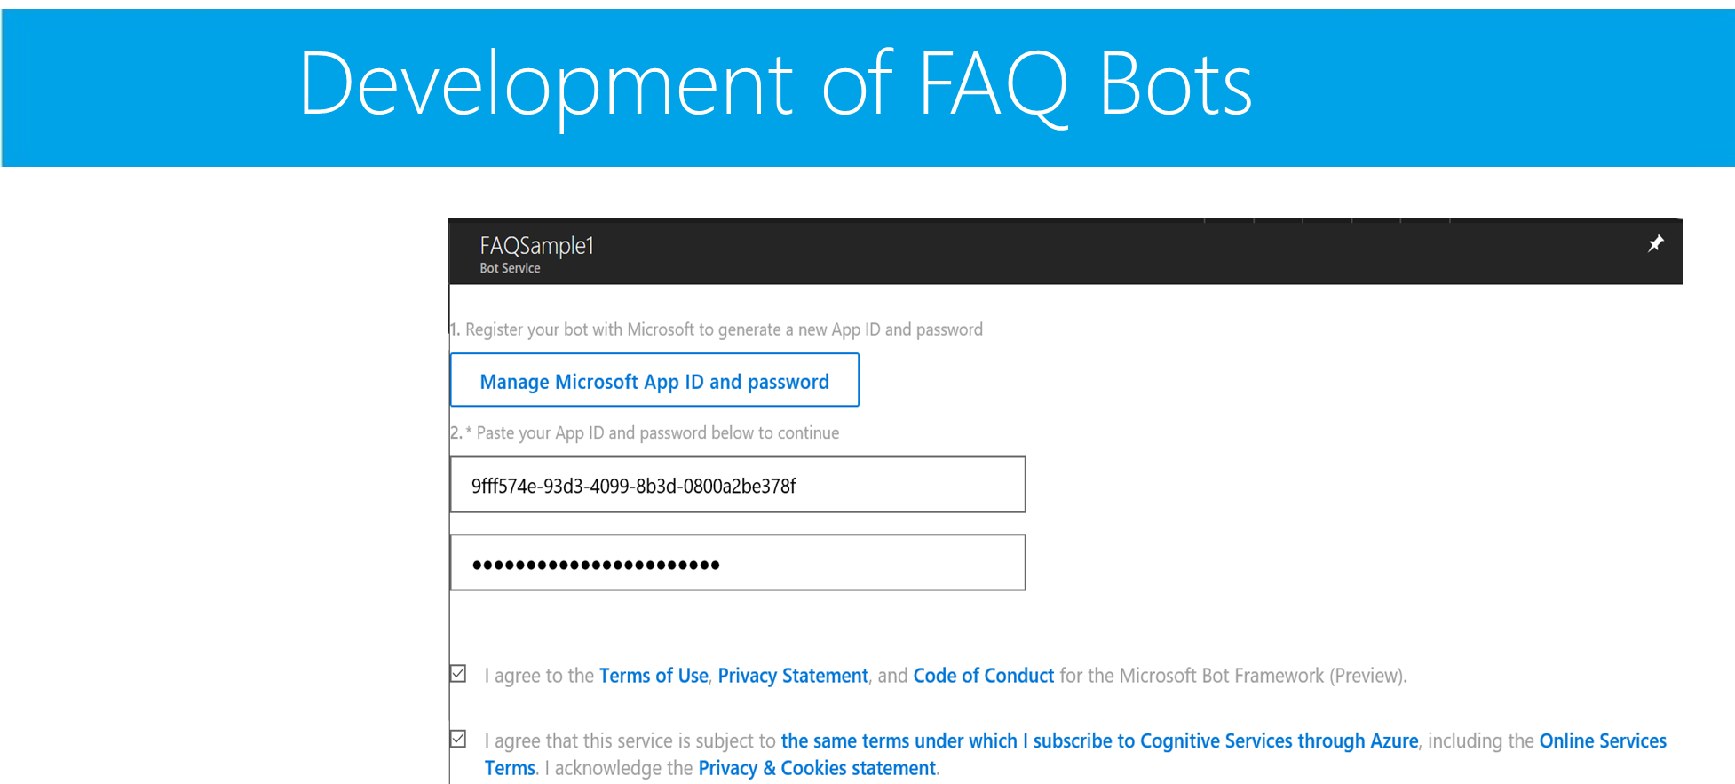

Slide 24
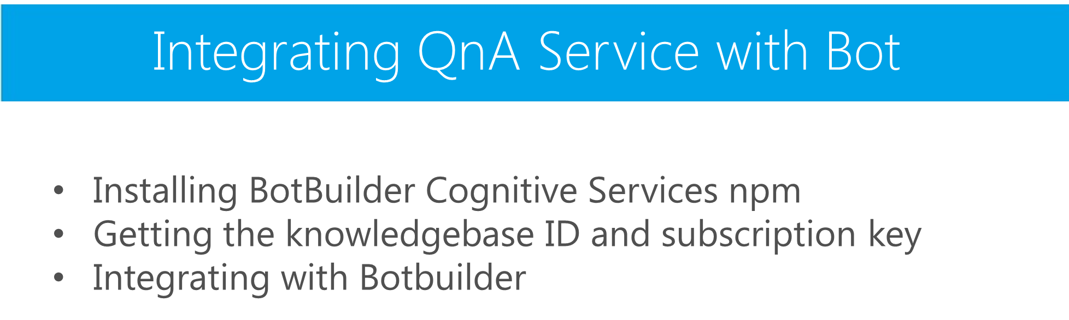

Slide 25

Hands on Lab

Slide 26
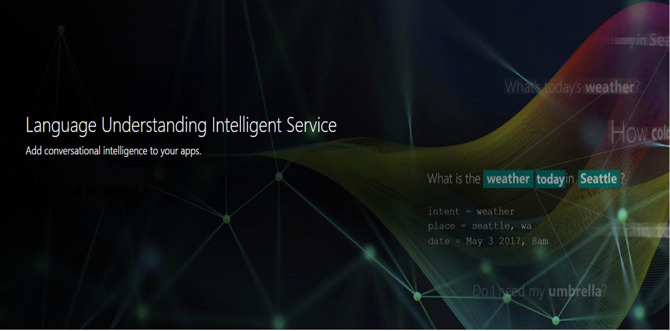

Slide 27
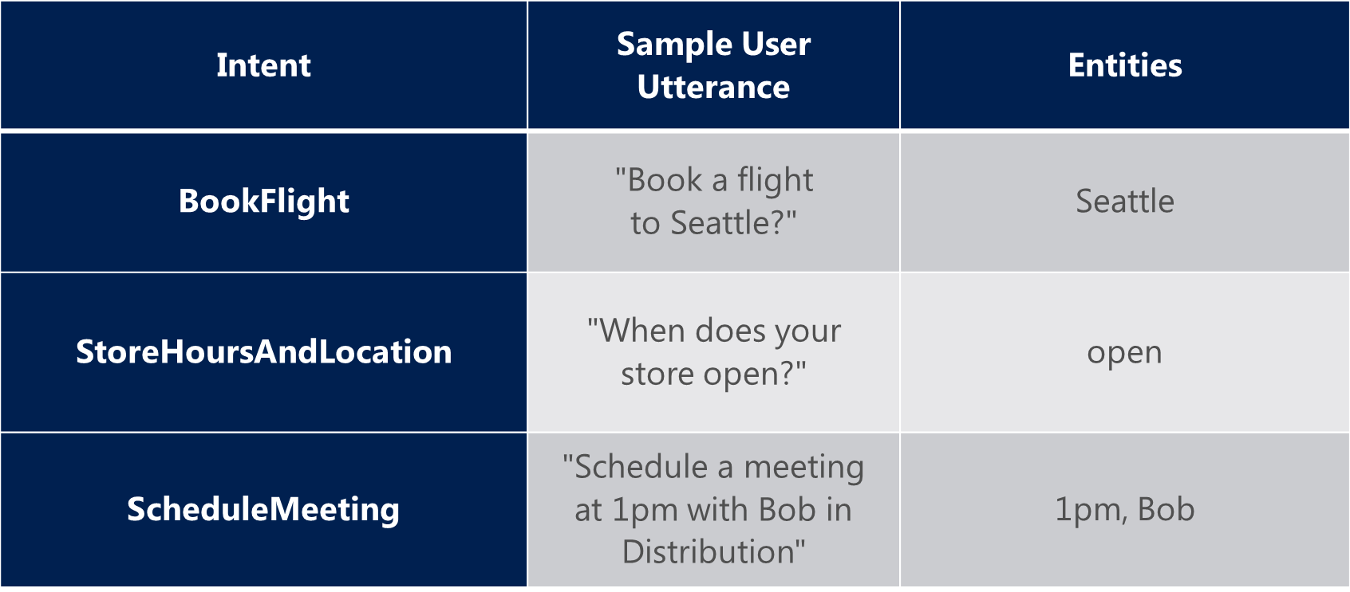
LUIS – KEY Concepts

Slide 28
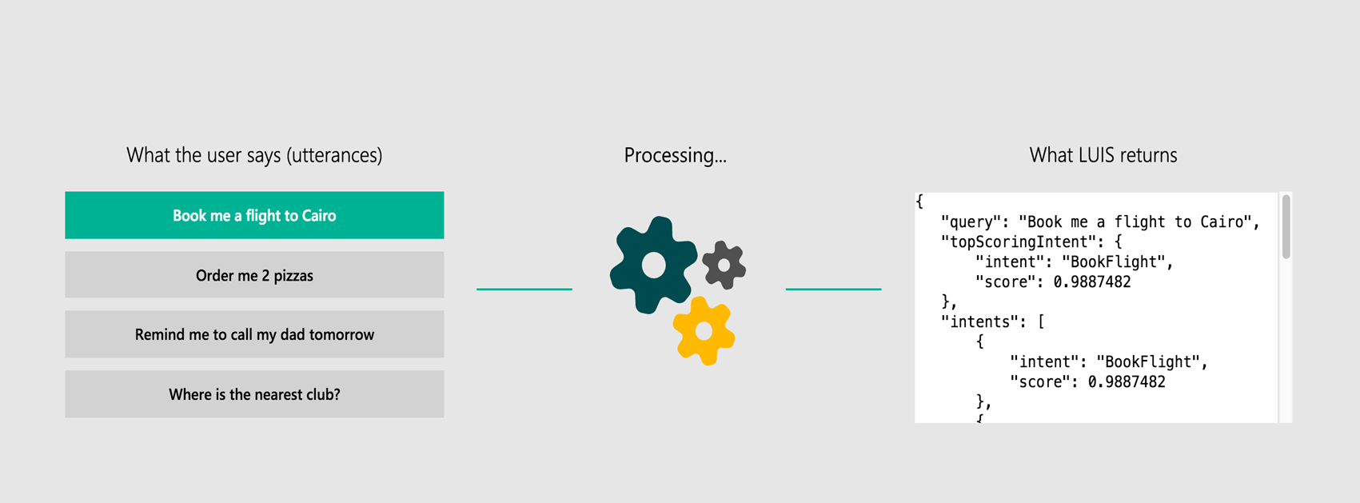
LUIS – KEY Concepts

Slide 29


Slide 30

© 2017 Microsoft Corporation. All rights reserved.

